Slide 1
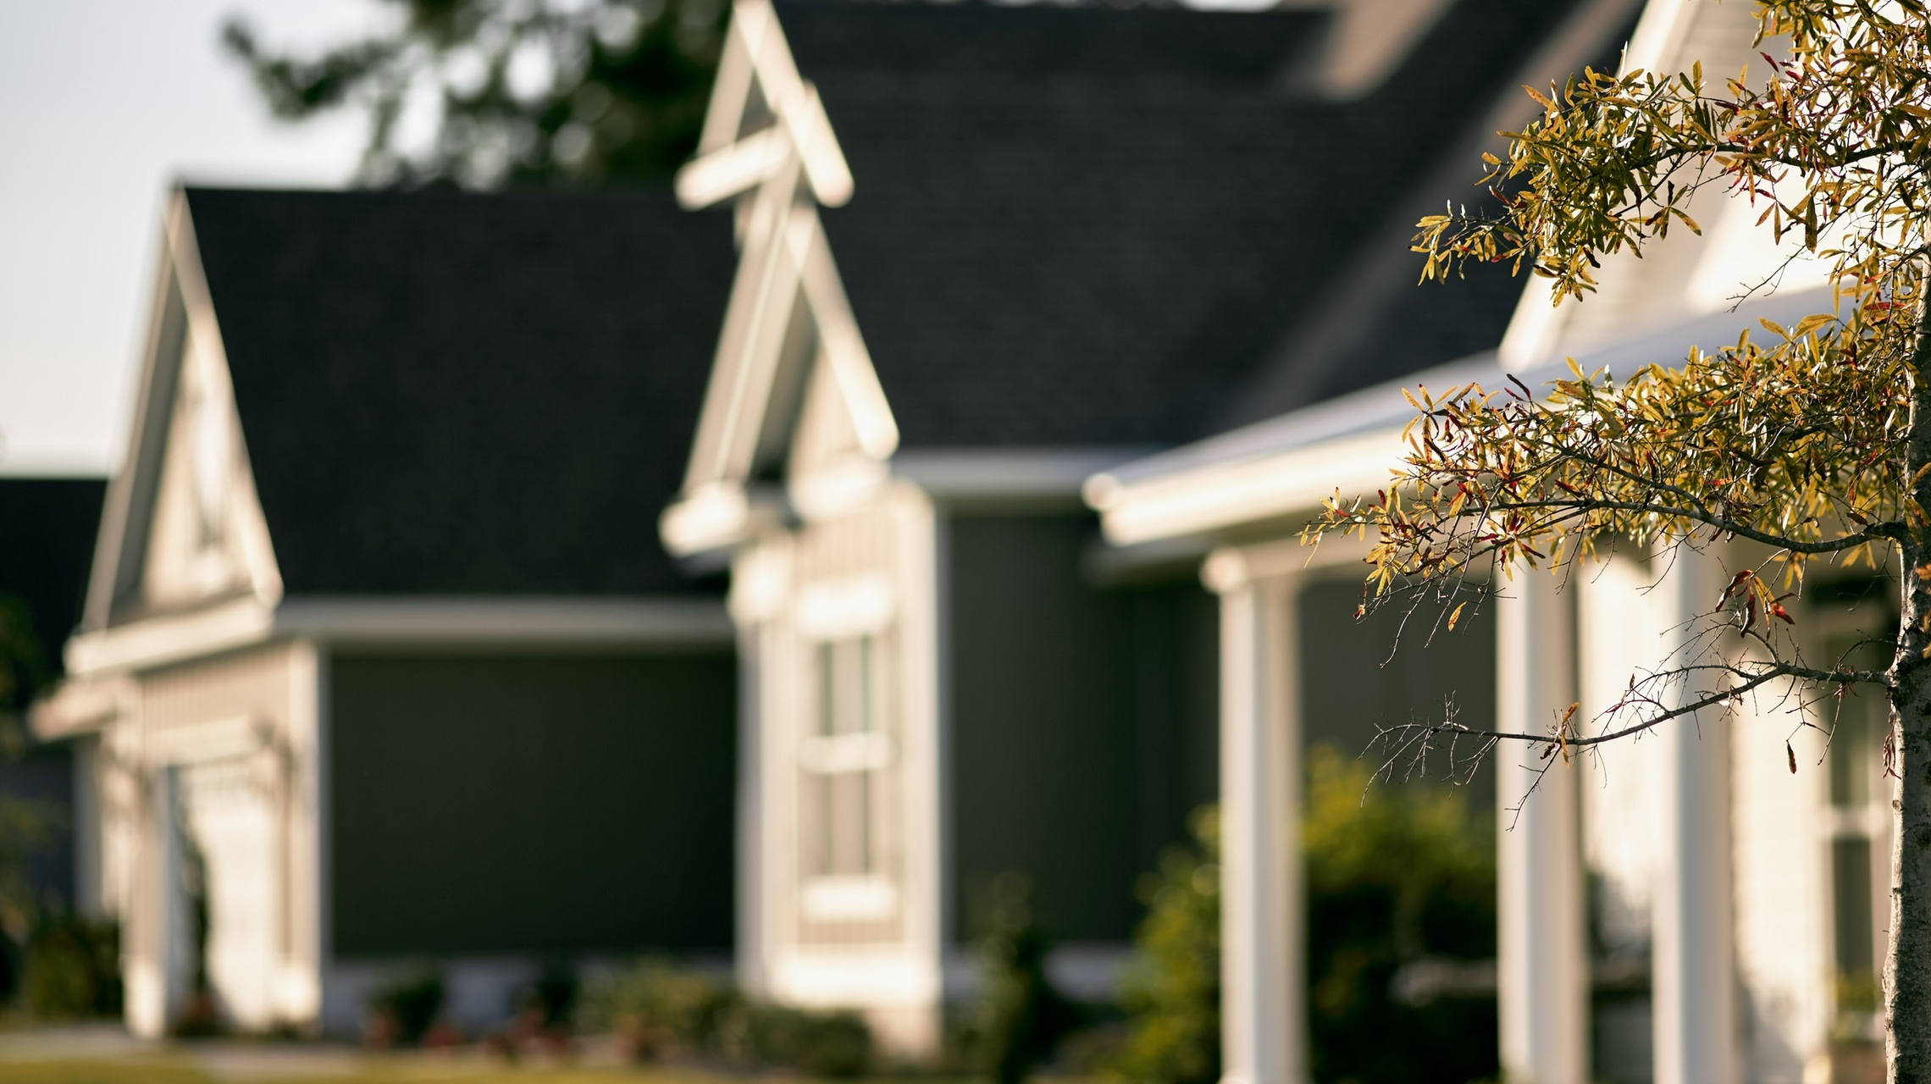

3BT SmartAI Home Surveillance System
Smarter Approach to Home Security
Notes:
Patricia

Slide 2
Team Members
Patricia Bermeo
Jordan Berry
Felix Bonilla
Thomas Schoenfelder
Notes:
All

Slide 3

Advisor
Ausif Mahmood, Ph.D
Notes:
Patricia

Slide 4
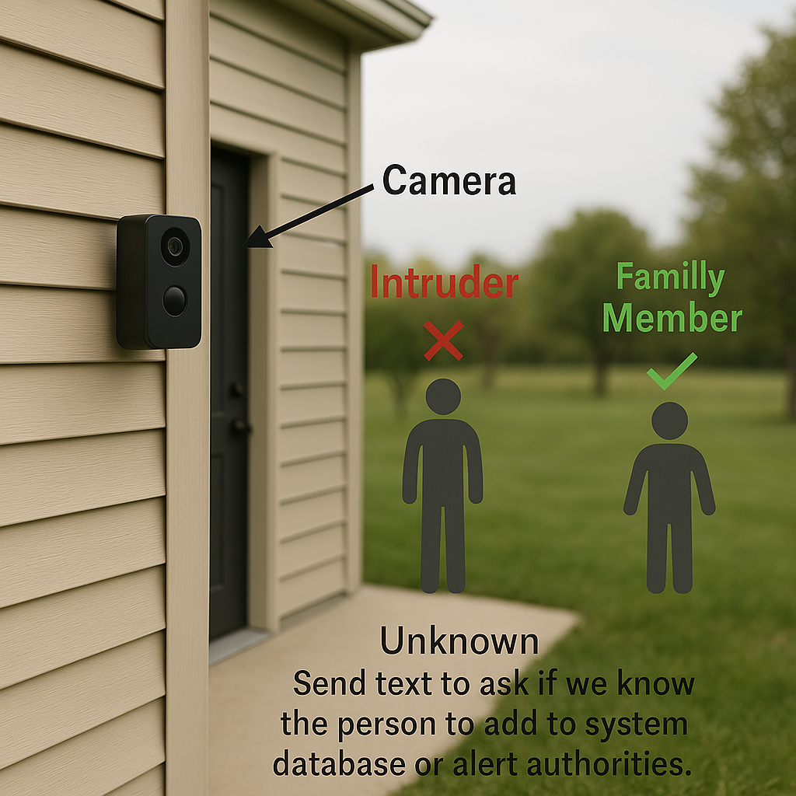
Introducing AI-Powered Smart Surveillance
Use advanced AI for facial recognition.
Distinguish between family and intruders to reduce false alarms.
Include behavior analysis for smarter & adaptive security.
Notes:
Thomas

Slide 5
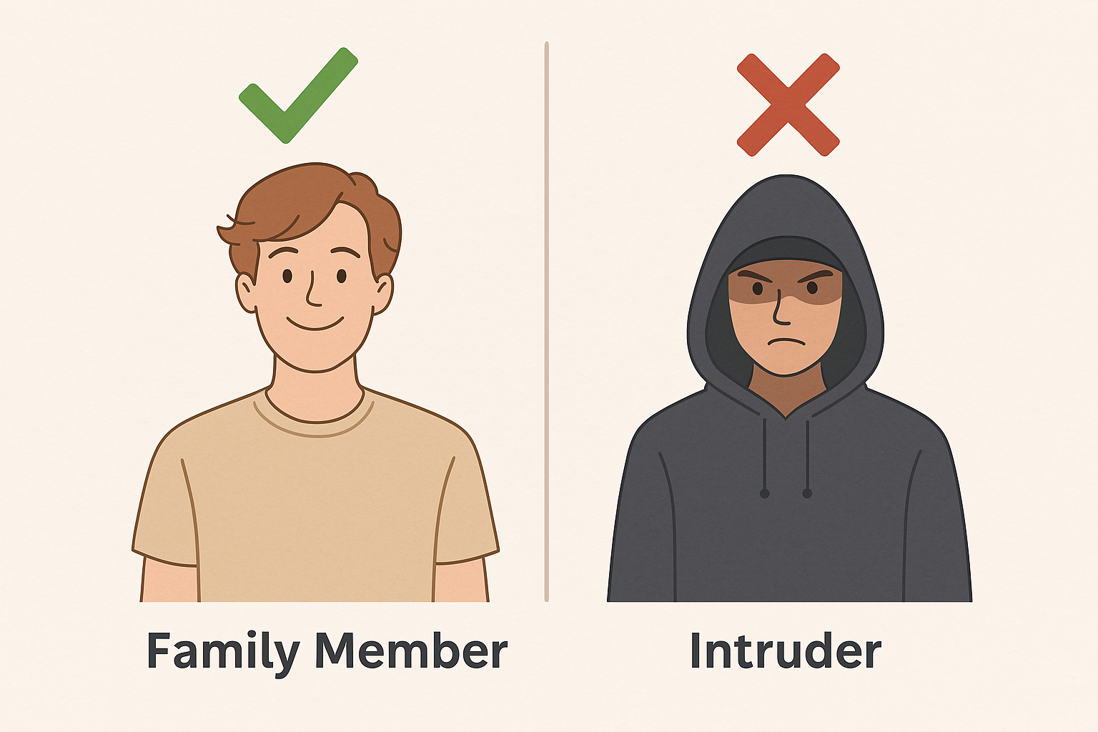
Key Objectives
Develop a smart surveillance system with behavior pattern analysis.
Identify unusual or suspicious activity proactively.
Overcome limitations of existing security systems like Ring.
Notes:
Thomas

Slide 6
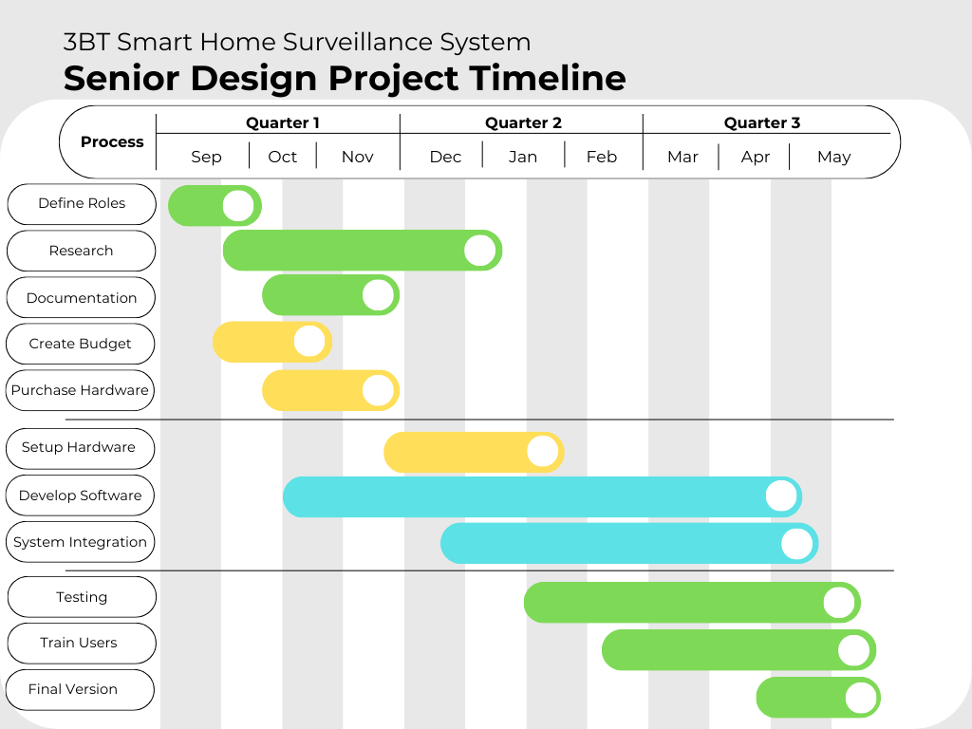
Notes:
Thomas

Slide 7
Marketplace or Community Value
Advanced Recognition: Differentiates family members and intruders.
Real Time Alerts: Sends instant notification for detected activity
Affordability: Costs under $250 with advanced AI capabilities.
Notes:
Patricia

Slide 8
Competitor Analysis
Features | Ring | Nest Cam | Arlo Pro | 3BT
Facial Recognition | No (Motion detection only) | No (Facial Detection, not recognition) | Yes | Yes (Advanced includes people and intruders)
Behavior-Based Alerts | No | No | No | Yes (Includes behavioral analysis)
Resolution | 1080p | 1080p | 2K | 1080p or higher
Night Vision | Yes | Yes | Yes | Yes (Infrared NoIR Camera)
Price | $ 150 | $160 | $200 | Under $250
Cloud Storage | Available (Subscription) | Available (Subscription) | Available (Subscription) | No (Local Storage & Subscription-Free)
Security (Encryption Level) | AES-128 | AES-128 | AES-128 | AES-256
Notes:
Patricia

Slide 9
Cost of the Project
Hardware Costs: ApProx. $212
Software Costs: No recurring fees Open-Source software UNDER MIT LICENSE
Total Estimated Budget: $212
Notes:
Jordan

Slide 10
Selling Price & Licensing Method
The 3BT SmartAI Home Surveillance System will be sold for under $250
Licensing options will include a one-time purchase for the hardware
Open-source software components under MIT License
Notes:
Jordan

Slide 11
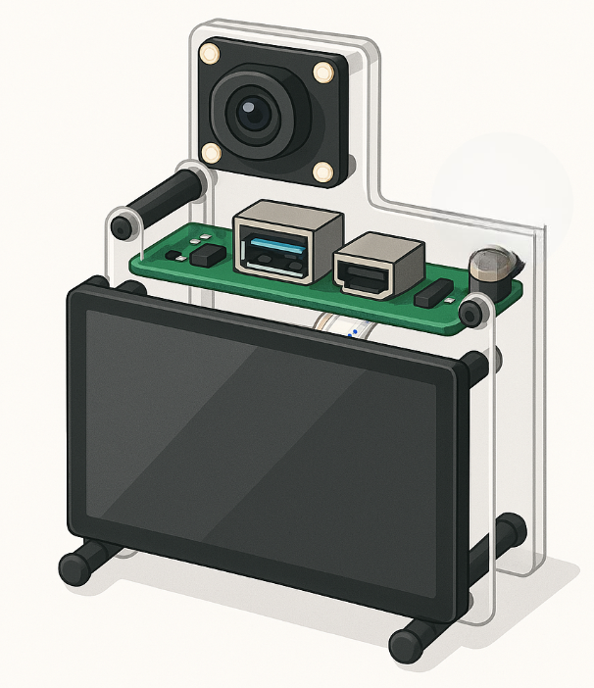
Frame Infrastructure & Components
Notes:
Jordan

Slide 12

Hardware Components
Frame: Protective cover plate/ Camera mounting plate
Power Supply: Direct connection to power
Connectivity: Wi-Fi-enabled for remote access and mobile notifications
Notes:
Jordan

Slide 13
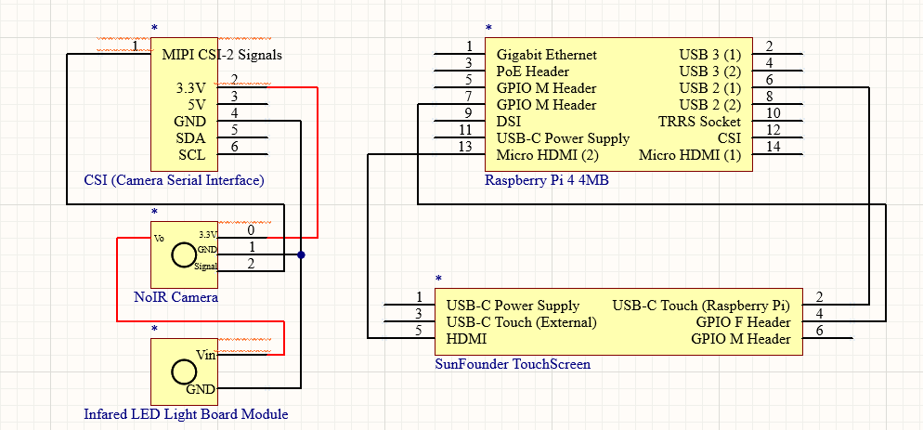
Schematics
Notes:
Jordan

Slide 14
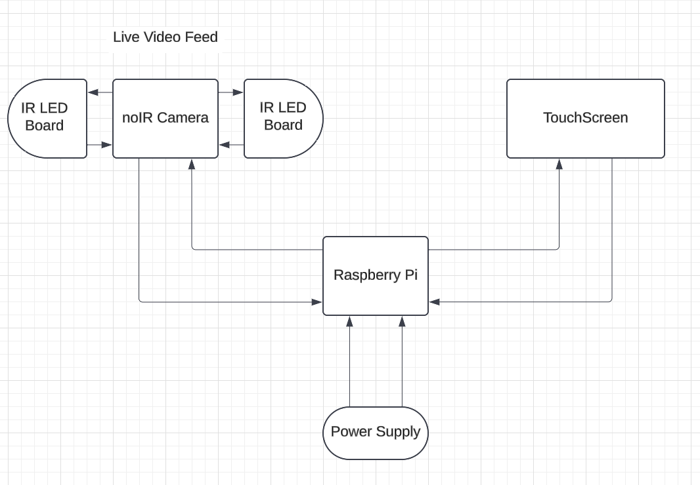
Block Diagram
Notes:
Jordan

Slide 15
Software Architecture
Camera feed management for live video with future multi-camera support.
Facial recognition using OpenCV, Python, DeepFace
Behavior analysis to identify suspicious actions
Local storage for profiles and footage, eliminating cloud fees.
Real-time alerts and notifications via mobile.
Notes:
Felix

Slide 16
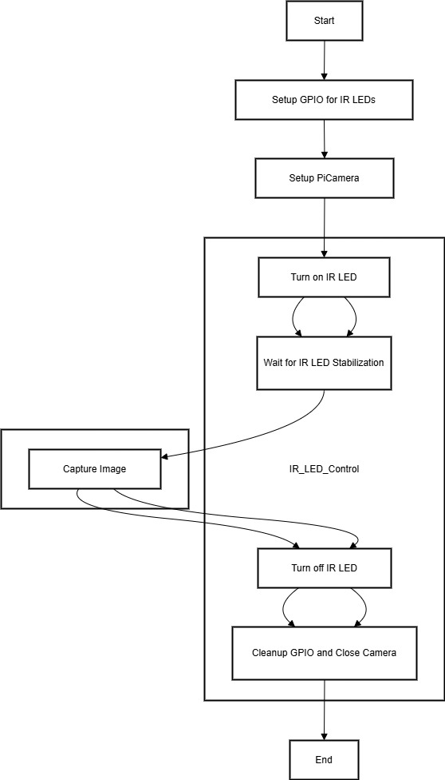
Software Diagram
Notes:
Felix

Slide 17

Hardware & Software List
Notes:
Jordan

Slide 18
Hardware List
Item | Cost |  | Quantity |  | Total
SunFounder 7 Inch Touchscreen | $89.99 |  | 1 |  | $89.99
Raspberry Pi 4 4GB Model B | $60.95 |  | 1 |  | $60.95
Raspberry Pi NoIR Camera Module V2 | $18.99 |  | 1 |  | $18.99
SanDisk 32GB Ultra micro SD card | $9.99 |  | 1 |  | $9.99
CanaKit Raspberry Pi 4 Micro HDMI Cable | $14.95 |  | 1 |  | $14.95
USB Type C Adapter for Raspberry Pi 4 Model B Power Supply Cord with ON/Off Switch | $9.99 |  | 1 |  | $9.99
2 Pcs 3W 850 IR Infrared LED Light Board Module for Raspberry Pi Camera Night Vision | $6.99 |  | 1 |  | $6.99
Total: |  |  |  |  | $211.85
Notes:
Jordan

Slide 19
Software List
Operating System: Raspberry Pi Linux
Programming Languages: Python
AI Libraries: Deepface OpenCV
Notes:
Felix

Slide 20
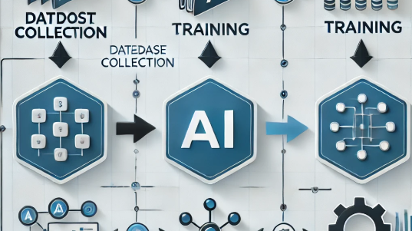
AI Model Training and Fine-Tuning
Dataset Collection: Gather data to train AI models for accurate recognition of household members.
Training Models: -Train models for facial recognition under various lighting conditions -Train models to distinguish between family members, and intruders.
Performance Optimization: -Regularly refine the models to reduce false positives and false negatives. -Periodically retrain the models using real-world data to improve performance.
Notes:
FELIX

Slide 21
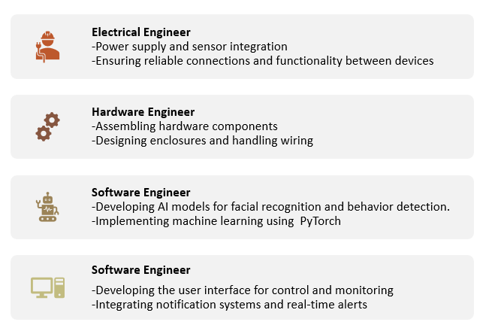
Task Distribution
Deepface
Notes:
FELIX

Slide 22
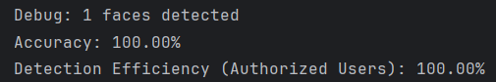
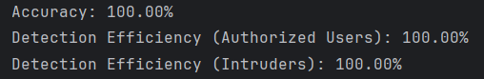

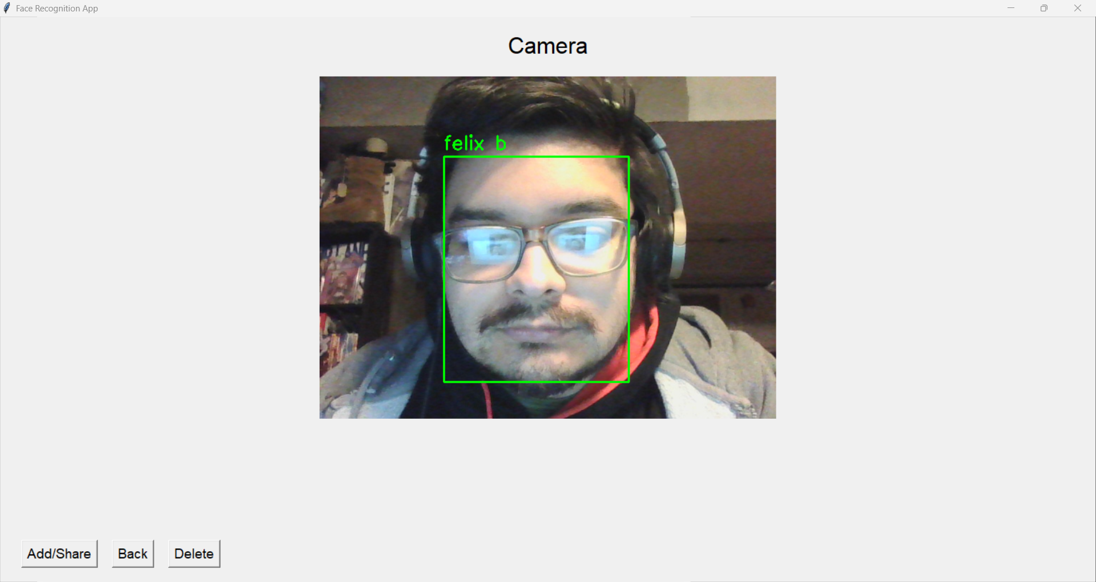
Results
SmartAI Accuracy
Detection Efficiency
Unauthorized Access and Mobile Alert Feature
Notes:
Thomas

Slide 23
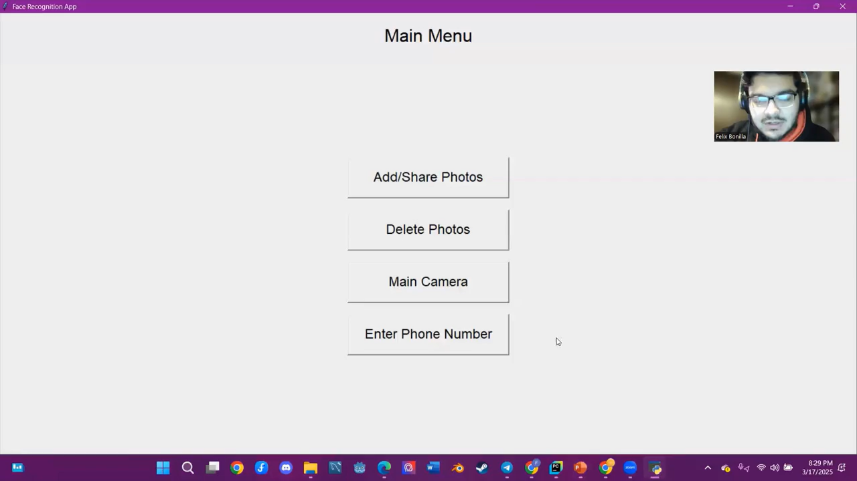
System Functionality Demonstration
Notes:
Thomas

Slide 24
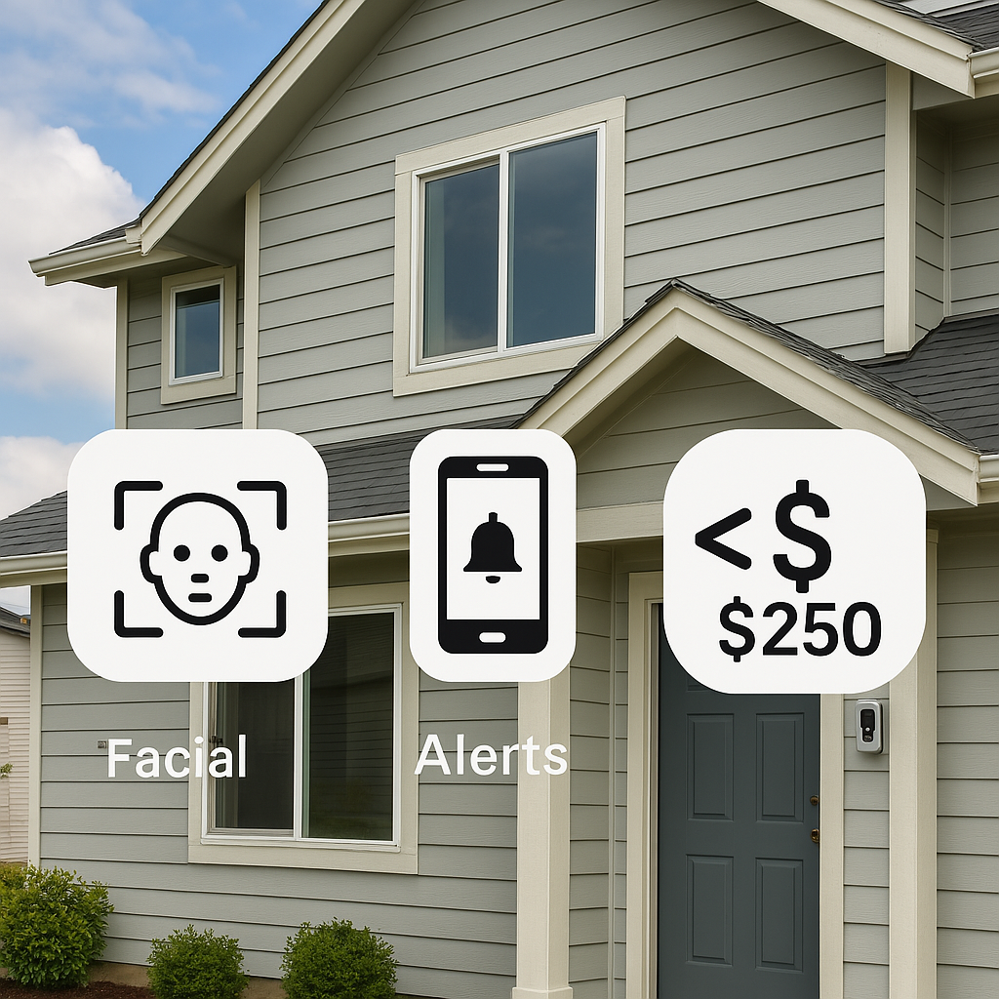
Conclusion
Combines facial recognition and behavior analysis.
Reduces false alarms, increases security.
Costs under $250, making it an affordable high-tech solution.
Notes:
FELIX

Slide 25
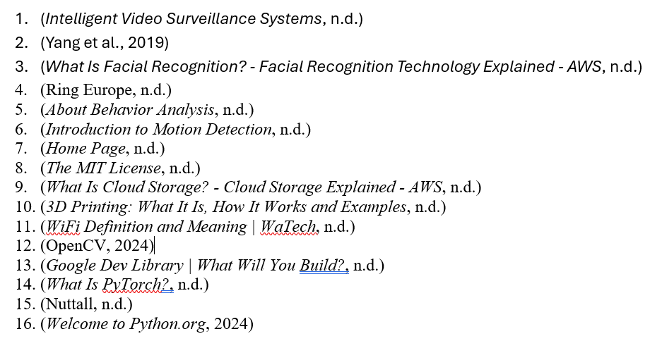
References
Notes:
FELIX

Slide 26

Thanks
Notes:
FELIX

